Slide 1
How to make an Alexa Skill

Slide 2
Step One: Setting Up A Skill
Things you will need:
An Amazon account
An Amazon Lambda Account
An Amazon Alexa Device
Smart Phone
First Set-Up Tasks:
Login to your Amazon Alexa Developer Account and connect you alexa to the account.
This is required

Slide 3
Step Two: Creating a Skill
To create the skill, navigate to Your Alexa Console and create new skill.
In order to create a new skill you need to do the following:
Choose a skill name: This is the name customers will see when you publish the skill. You can edit this name later on the Distribution page.
Select a default language
Choose a model. Example: Custom, Flash briefing,Smart home, Video etc.

Slide 4
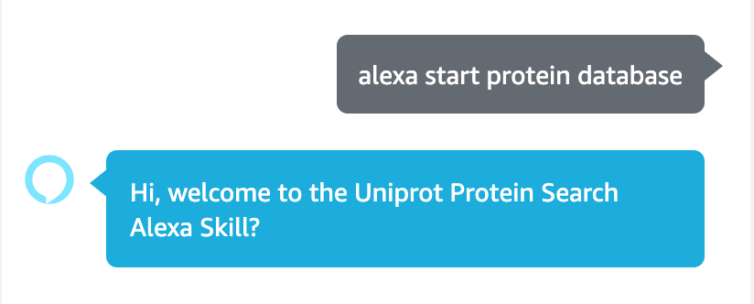
Step Three: Intents and Utterances
Invocation
What the user says to get the skill started:
Invocation set: "Protein database"
What user would say (ie): "start protein database" or "Alexa start protein database"
Intents
What the user says to perform an action
Type Types:
Custom
Built-In
mainly include the Help, Stop, Cancel, and Navigate Intents.
Can include other general intents as well

Slide 5
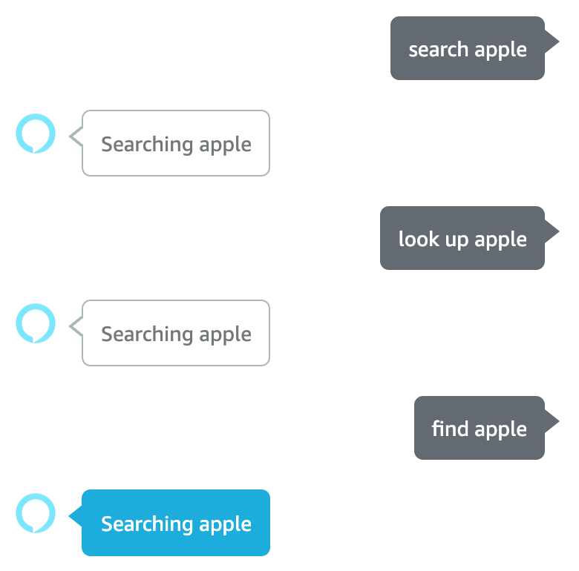
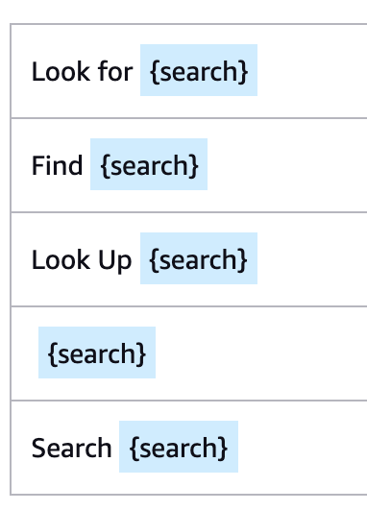
Step Three: Intents and Utterances CON.
Custom Intents:
Usually specified by a specific task
Contains Utterances
Sample of what the user would say/ask to perform an action
Slots
'Variable' that the user would enter and the backend would use to complete the task

Slide 6
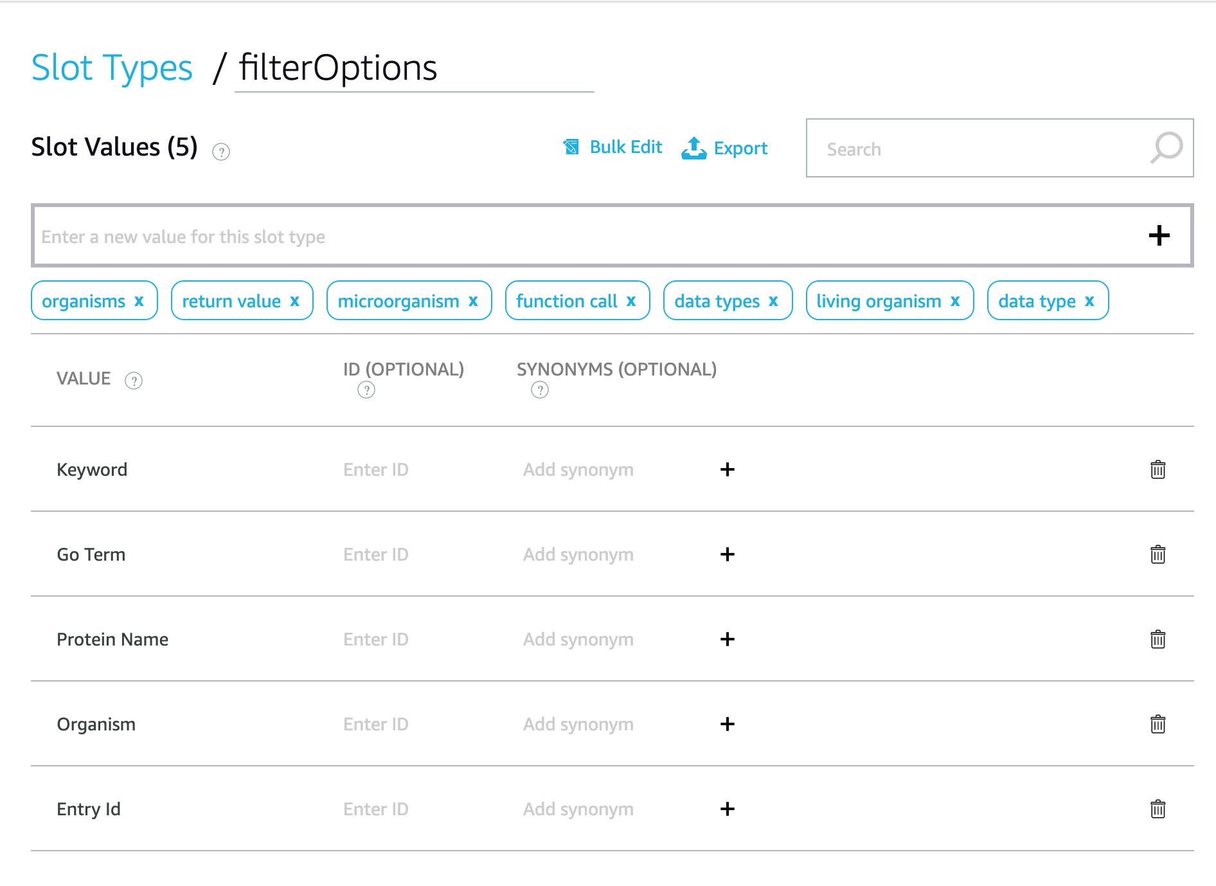
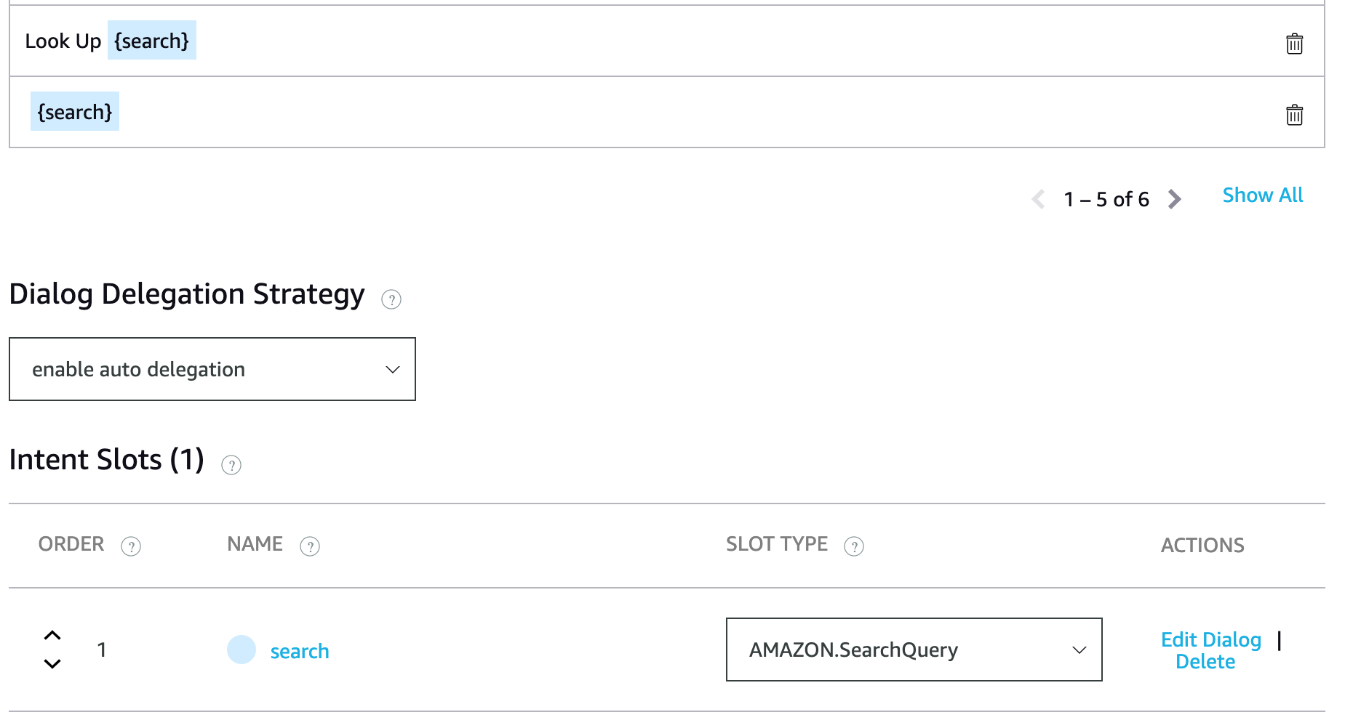
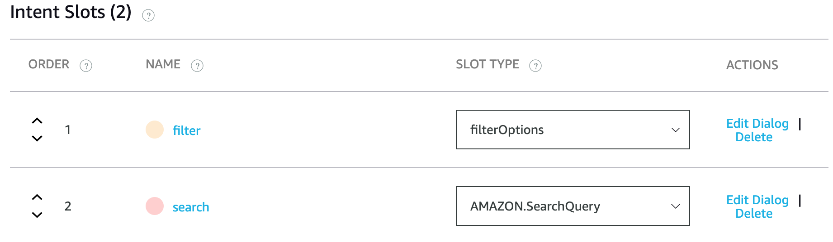
Step Four: Slots and Slot types
Intent Slots: The 'variable' in the utterance
Slot types: The options that the 'variable' can be
Custom
You can set the options for the 'variable'
Amazon's
These are Amazon's predefined list of options.
Ie. movies, actors, colors, numbers, etc

Slide 7
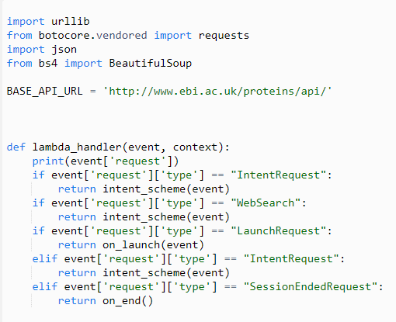
Step Five: Lambda
Requirements:
Need to have a registered AWS account
What is a lambda?
An event-driven, serverless computing platform
Can be written in Java/.NET/Node.js/Python
Handler function receives the event (usually JSON) and calls other functions
These other functions extract query parameters from the event JSON and make API calls

Slide 8
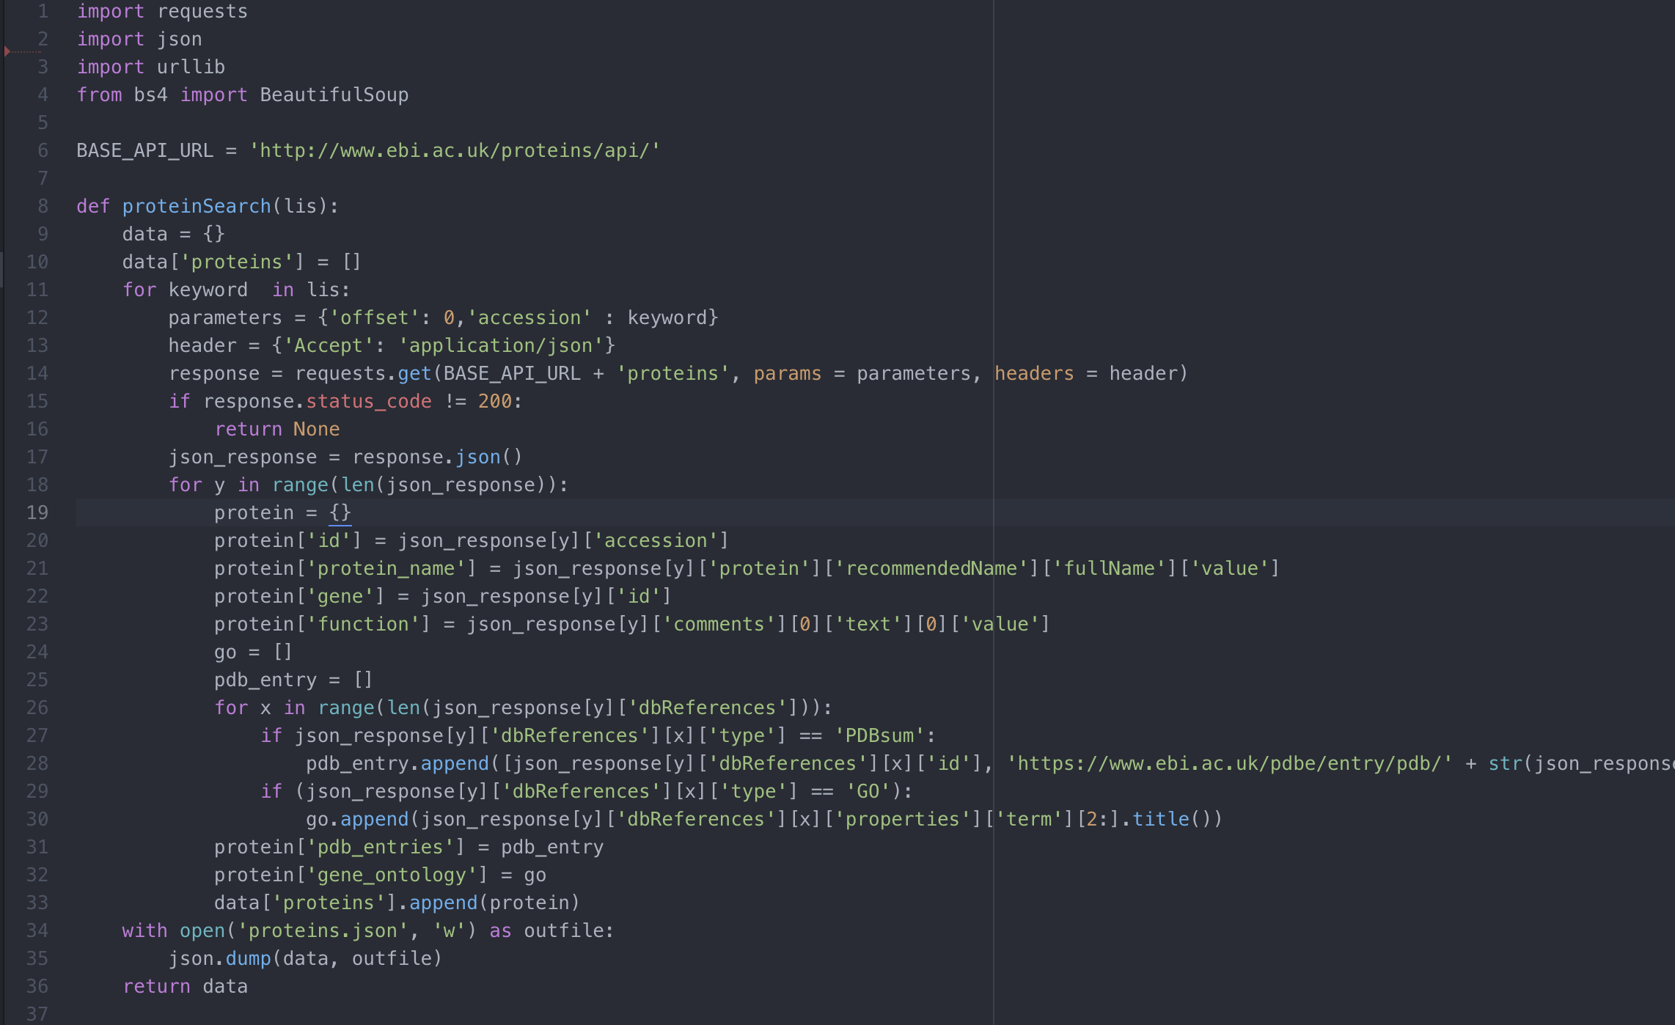
Step Six: API calls
A script file that has calls connecting to external libraries, modules, databases
Can call external API calls in this script file
These calls should be used with Amazon’s built-in API calls are not sufficient for your solution

Slide 9
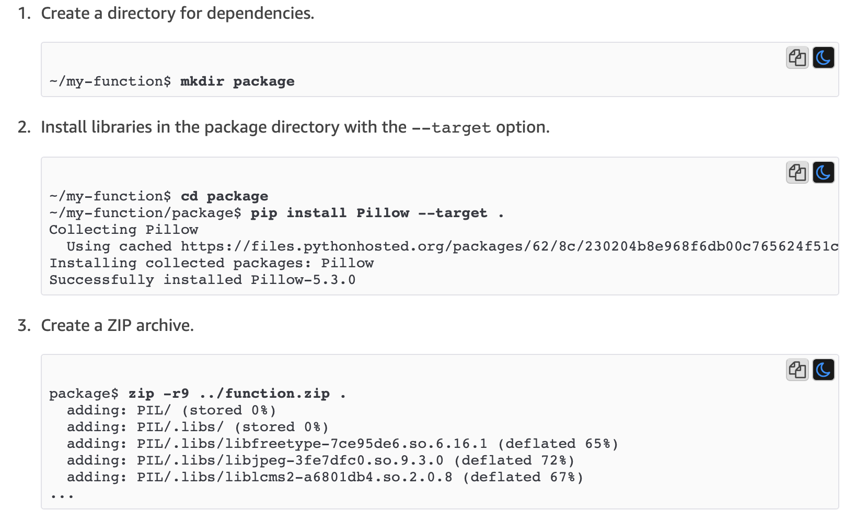
Step Seven: Connecting Lambda and API
You can either copy and paste your API calls into the Lambda function if Amazon has the libraries needed.
Another way is by zipping your API calls with the necessary dependencies and having a method handler in your lambda function

Slide 10
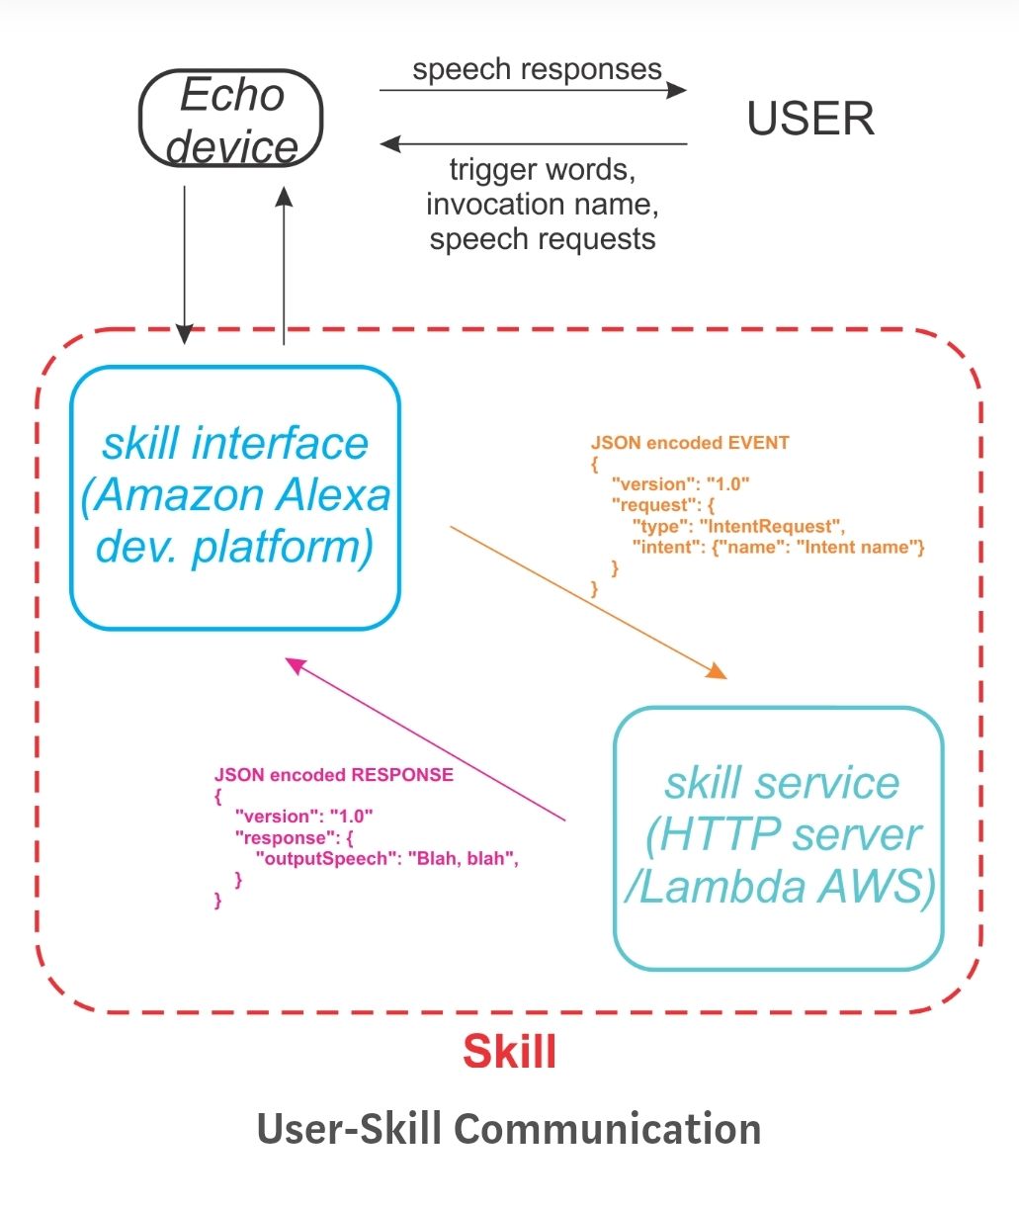
Overview

Slide 11
Step Eight: Testing
DEMO

